Slide 1
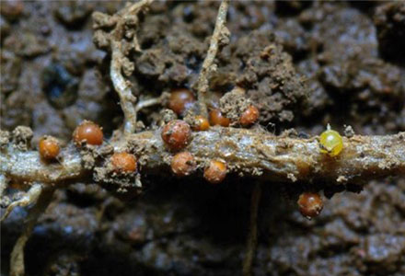


The effects of chitin and chitosan amendments on potato cyst nematode viability.
Ronald Manjoro
Supervisors: Dr Matt Back
Dr Tom Pope
Dr Joe Roberts

Slide 2
Background:
Potato cyst nematodes are an important pest causing substantial losses in the potato industry.
The pest can remain viable in the soil for ca.20 years.
Chemical options are being phased out due to their negative impact on human health and the environment.
Chitin offers an environmentally friendly alternative for the management of the pest.

Slide 3
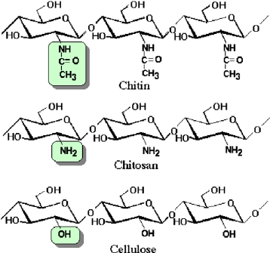
Aim
To understand if chitin and, its deacetylated derivative, chitosan can reduce the viability of potato cyst nematodes in between potato rotations.

Slide 4
Objectives
Determine the effects of different concentrations of chitin/chitosan on total viable cyst nematodes.
Evaluate the effects of chitin and chitosan on bacterial communities over time.
Evaluate the effects of chitin and chitosan on the fungal community.
Assess the effects of chitin and chitosan on soil chitinase activity.

Slide 5
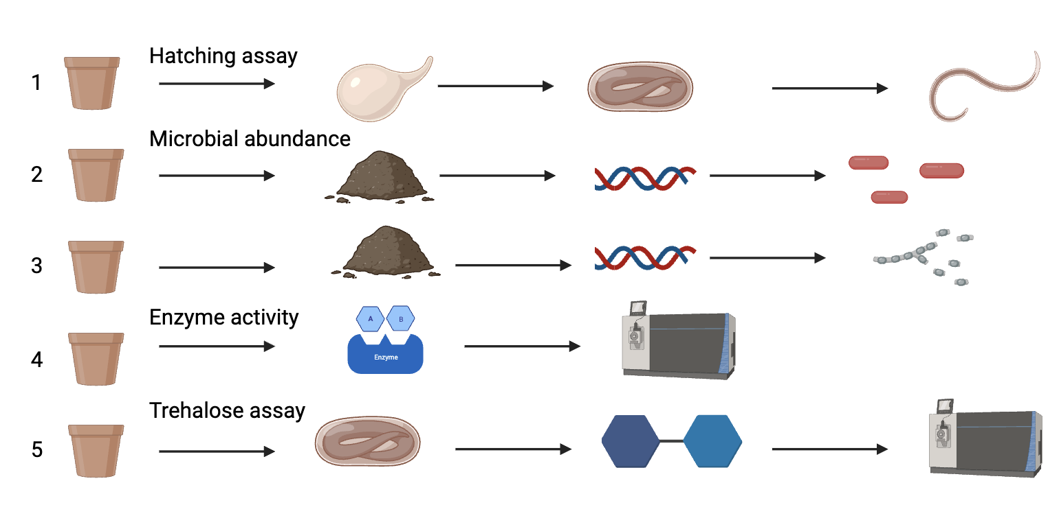
Experimental design
Five levels of chitin/chitosan (0%,0.1%,1%,2% and 5%) with 8 replicates per treatment.
Data will be collected at 0,3,6,9 and 12 weeks after treatment.

Slide 6
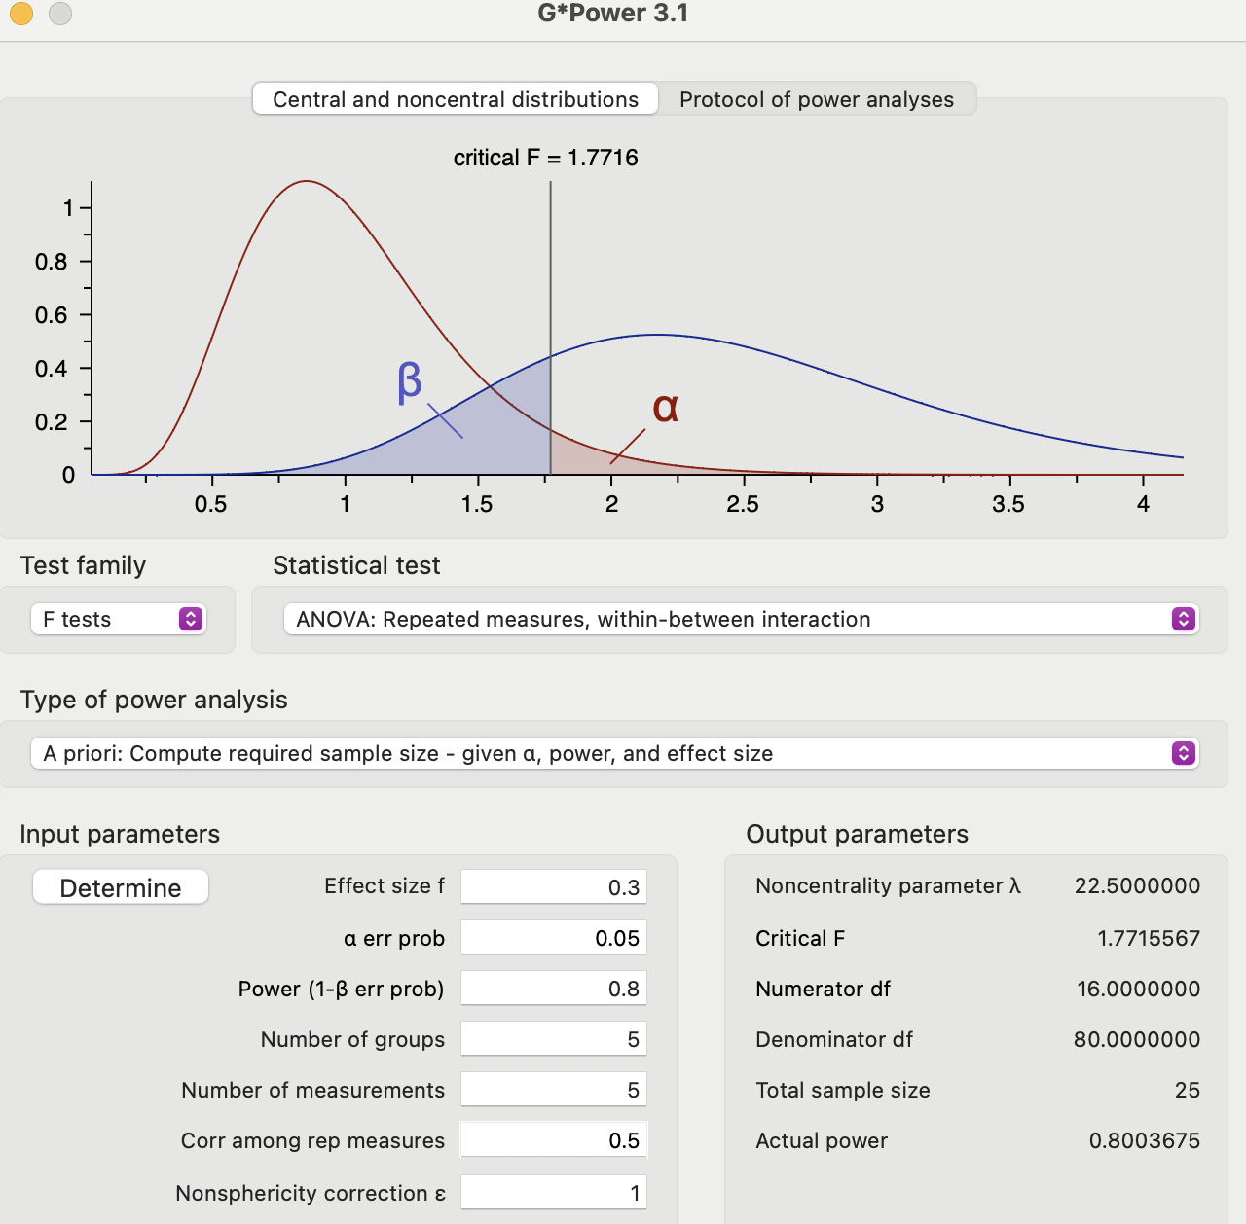
Power analysis
F²=F×F
Normalize the F²⁼(F²/1+F²)
Cohens F with G.power
Delong et al., 2020 observed 27% differences between control and chitosan treatments (F statistic 2.2)
55% reduction (Khalil and Badawy,2012)
Mittal et al(1995):more than 55% difference between treatments and control (F:3.75)
Cluster analysis showed only 36% similarity in soil microbial communities (Creitou et al.,2013)

Slide 7
Data analysis
ANOVA to assess the effects of chitin or chitosan concentration and time and their interaction.
Linear regression (mixed-effects) models the relationship between chitin concentration, nematode viability microbial abundance and chitinase activity over time.

Slide 8
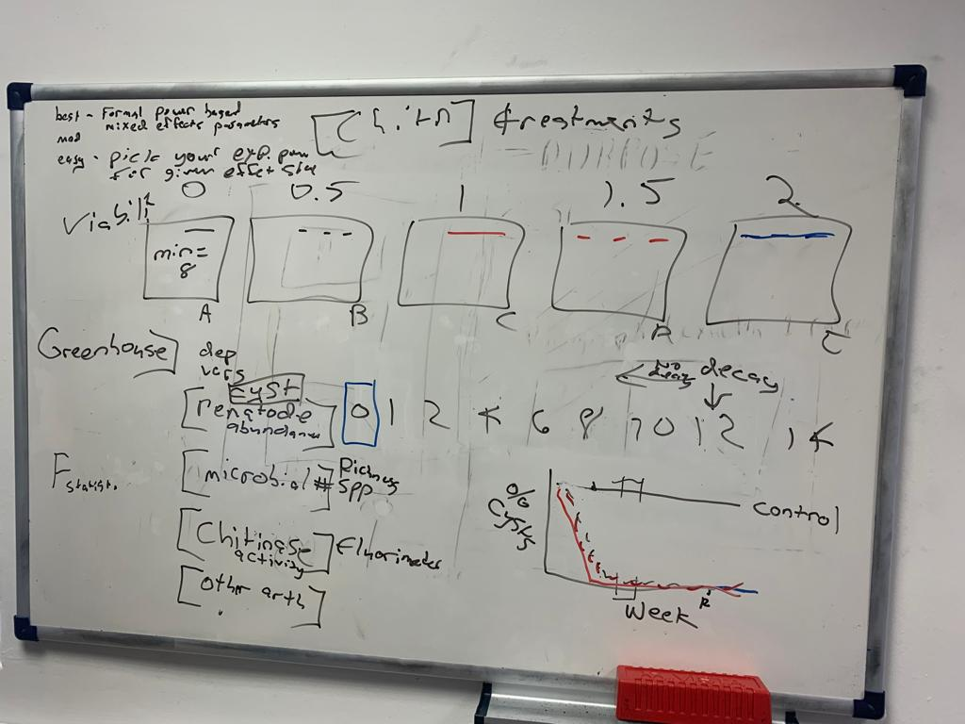
Thank you

